Slide 1
Efficiency-Driven Deep Learning Models for Credit Card Fraud Detection: A Comparative Study and Optimization Approach
1
Team 27

Slide 2
Table Of Contents
2
Introduction
Motivation
Collected Data
04. Workflow
05. Proposed Methodology
06. Conclusion

Slide 3
Introduction
3
In the dynamic landscape of digital transactions, the ubiquitous use of credit cards has catalyzed unprecedented financial growth and convenience. However, this surge in online transactions has also precipitated a parallel rise in the sophistication of credit card fraud, presenting a formidable challenge to the security of financial ecosystems worldwide. Traditional fraud detection methods, while robust in their time, are now strained by the rapid evolution of fraudulent techniques. As we stand at the nexus of technological innovation and financial vulnerability, our paper, titled "Efficiency-Driven Deep Learning Models for Credit Card Fraud Detection: A Comparative Study and Optimization Approach," endeavors to navigate this intricate terrain.

Slide 4
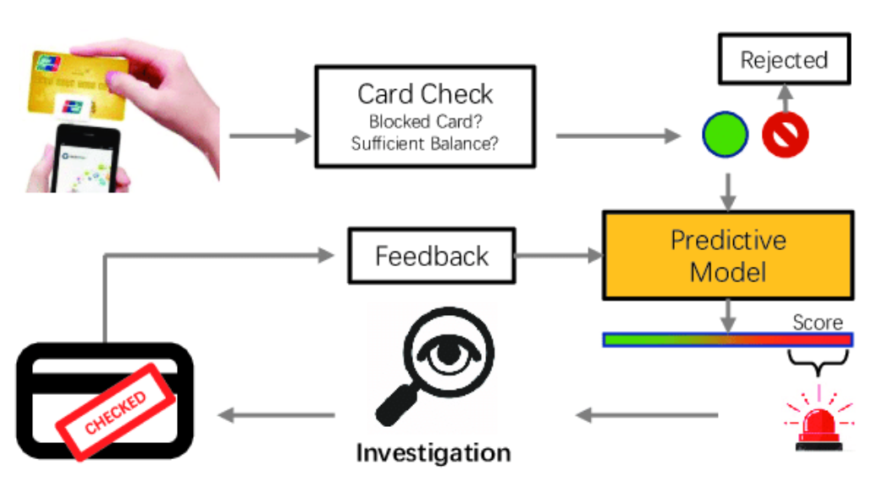
Motivation
4
Credit card fraud poses a relentless challenge in our digitally-driven world. As online transactions surge, so does the sophistication of fraudulent activities. Current detection methods often fall short, demanding a paradigm shift. In this landscape, our research emerges, driven by the imperative to not only bolster security but to redefine the efficiency benchmarks of credit card fraud detection.

Slide 5
5
Why This Matters:
Economic Impact: Fraudulent transactions result in staggering financial losses globally, impacting individuals and institutions alike.
Trust at Stake: Maintaining customer trust is pivotal in the financial realm. Our research seeks to fortify this trust through cutting-edge fraud detection.
Our Aim:
We aim to conduct an exhaustive comparative analysis of various deep learning models employed in credit card fraud detection. Through this, we intend to unveil the nuanced strengths and weaknesses of each model, providing a comprehensive understanding of their comparative efficacy.
Going beyond comparison, our mission extends to proposing and implementing innovative optimization approaches. We aspire to enhance the efficiency, adaptability, and real-world applicability of these deep learning models. This optimization journey encompasses not only theoretical advancements but also the practical strategies required for seamless integration into existing fraud detection frameworks.

Slide 6
Diverse Deep Learning Architectures: We explore advanced neural network designs, moving beyond conventional models, to understand their nuanced contributions to credit card fraud detection.
Comparative Benchmarking: Unlike past studies, we conduct an in-depth comparison of various deep learning models, revealing their strengths and weaknesses across diverse conditions and datasets.
Efficiency Metrics Redefined: Beyond accuracy, we redefine efficiency metrics, introducing measures for computational efficiency, real-time adaptability, and scalability, offering a comprehensive evaluation of practical utility.
Optimization Strategies: Addressing the gap between theory and practice, we propose tailored optimization strategies to enhance the efficiency of deep learning models when integrated into existing credit card fraud detection systems.
Adaptability to Emerging Fraud Techniques: Our study doesn't just analyze historical fraud patterns; we focus on designing models with high flexibility and continuous learning to adapt to emerging fraud techniques.
Practical Implementation Guidelines: Going beyond theory, we provide concise practical guidelines, empowering industry practitioners and decision-makers for a seamless transition to cutting-edge deep learning models from traditional approaches.
6

Slide 7
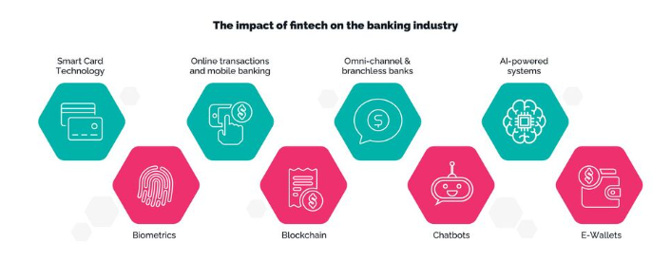
Industry-Relevant Insights:
7
Fintech and Banking Impact: Our findings have direct implications for the fintech and banking sectors. We offer insights that are not just academically intriguing but are designed to be immediately applicable, fostering a more secure financial ecosystem.
Cybersecurity Standards Elevation: By contributing to the advancement of credit card fraud detection, we indirectly contribute to raising overall cybersecurity standards. This has implications beyond the financial sector, influencing broader discussions on securing digital transactions.

Slide 8
WORKFLOW
8
.
Data Collection:
We initiated the research by collecting diverse credit card transaction datasets, ensuring representation across various timeframes and transaction types.
2. Preprocessing and Feature Engineering:
We begin the preprocessing process by addressing missing values and outliers in the datasets. Simultaneously, we applied feature engineering techniques to amplify the richness of information within the dataset.
3. Model Selection:
Proceed with the exploration of deep learning architectures, including Convolutional Neural Networks (CNNs), Recurrent Neural Networks (RNNs), and transformers. Make informed choices based on the suitability of models for sequential and time-series data.
4. Adaptability Testing:
Gauging the adaptability of models to emerging fraud techniques through simulated real-time scenarios. And prioritizing the assessment of continuous learning capabilities embedded within the models.
5. Validation and Fine-Tuning:
Validate the performance of models on an independent test dataset. Refine models based on validation outcomes, focusing on optimizing their efficiency and precision.
6. Results and Discussion:
Showcasing a comprehensive presentation of results, encompassing detection accuracy, efficiency metrics, and adaptability. Engaging in a meticulous analysis, emphasizing model strengths, limitations, and the consequential impact of optimization strategies.

Slide 9
Dataset
9
The dataset is composed mainly of numerical variables resulting from a PCA transformation (V1 to V28). Additionally, it includes 'Time' (seconds elapsed since the first transaction) and 'Amount' (transaction amount), aiding in cost-sensitive learning.
'Class' denotes the response variable, with 1 representing fraud and 0 otherwise. Because of severe class imbalance, using Area Under the Precision-Recall Curve (AUPRC) is suggested for accurate assessment, as traditional accuracy measures lack relevance in unbalanced classification.
The dataset contains 492 frauds among 284,807 credit card transactions in September 2013, resulting in a highly imbalanced dataset with frauds accounting for 0.172% of all transactions.

Slide 10
Proposed Methodology
10
Our algorithm's methodology revolves around optimizing machine learning models using carefully chosen hyperparameters that exhibit consistent strong performance across multiple datasets. Specifically, for K-Nearest Neighbors (KNN), we have selected and set the hyperparameters to get a higher accuracy. Same has been done with XGB booster, LGBM.
Training procedure :
Our approach commences with preprocessing each dataset to prepare it for analysis. Subsequently, we apply the K-Nearest Neighbors (KNN), Linear Discriminant Analysis (LDA), and Logistic Regression (LR) models to the processed datasets. For every row in the dataset, each model generates a distinct predicted value. Specifically, we denote the predicted value obtained from the KNN model.

Slide 11
Conclusion
11
In conclusion, our research has navigated the complexities of modern financial security with a focus on innovation and practical applicability. Through a comprehensive exploration of diverse deep learning architectures, comparative benchmarking, and the introduction of novel efficiency metrics, we have unveiled nuanced insights into their contributions and limitations. The proposition of innovative optimization strategies bridges the theoretical-practical gap, enhancing the models' efficiency in real-world deployment. Emphasizing continuous learning and adaptability to emerging fraud techniques, our study sets a benchmark for fortifying credit card fraud detection. The provision of practical implementation guidelines further empowers industry practitioners, paving the way for a resilient and efficient future in the realm of financial cybersecurity.

Slide 12
Thank you!
12

